Slide 1
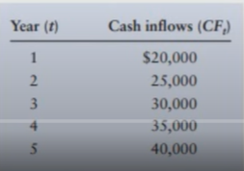
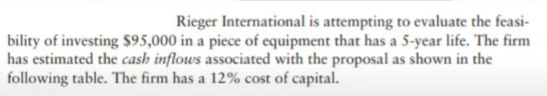
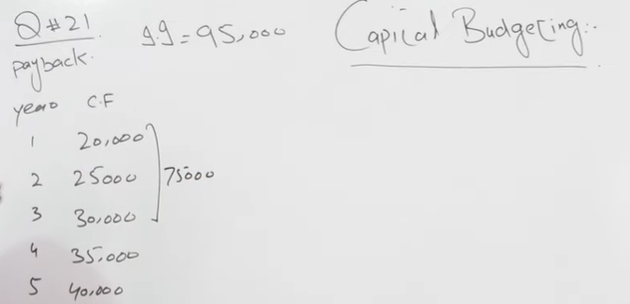
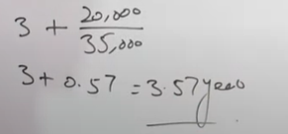
Payback
Lec-11 NPV,IRR,-Payback |Capital Budgeting Exercise (Part-11) |BBA,MBA|

Slide 2
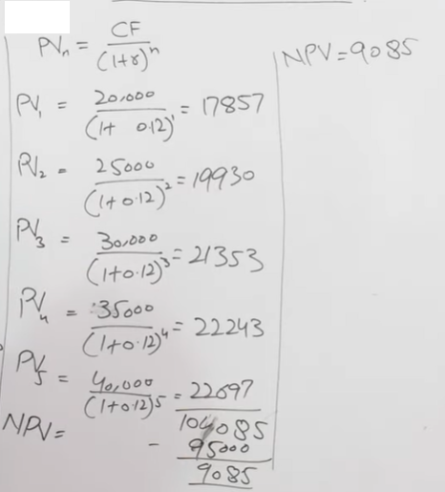
Net Present Value

Slide 3
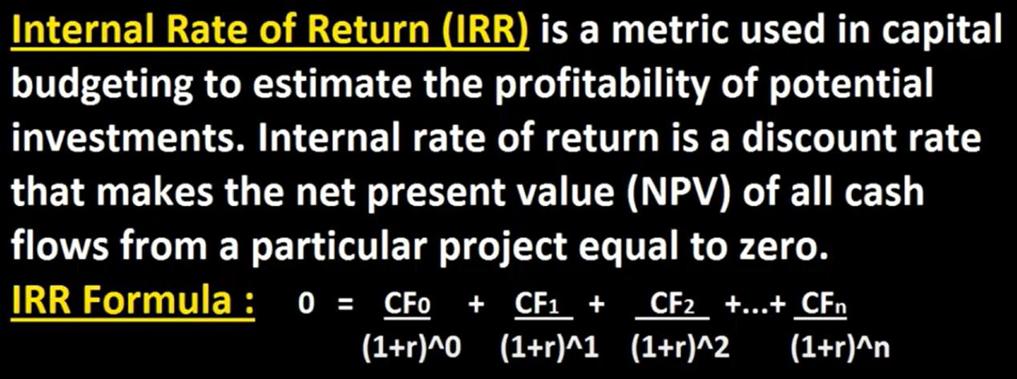
Internal Rate of Return (IRR)
Internal Rate of Return IRR With Example & IRR Formula ? Hindi / Urdu

Slide 4
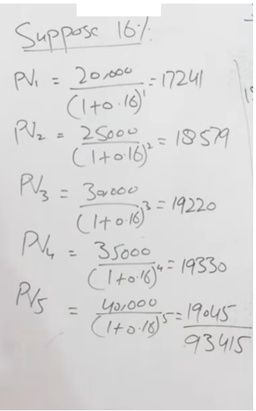
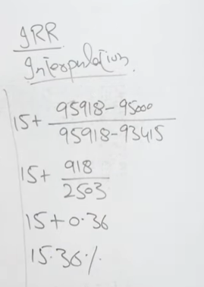

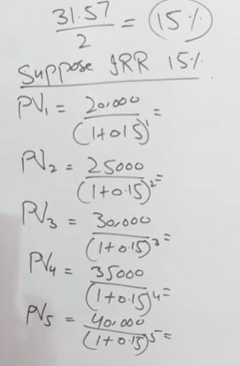

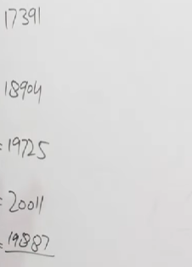
Internal Rate of Return (IRR)
Lec-11 NPV,IRR,-Payback |Capital Budgeting Exercise (Part-11) |BBA,MBA|

